Slide 1
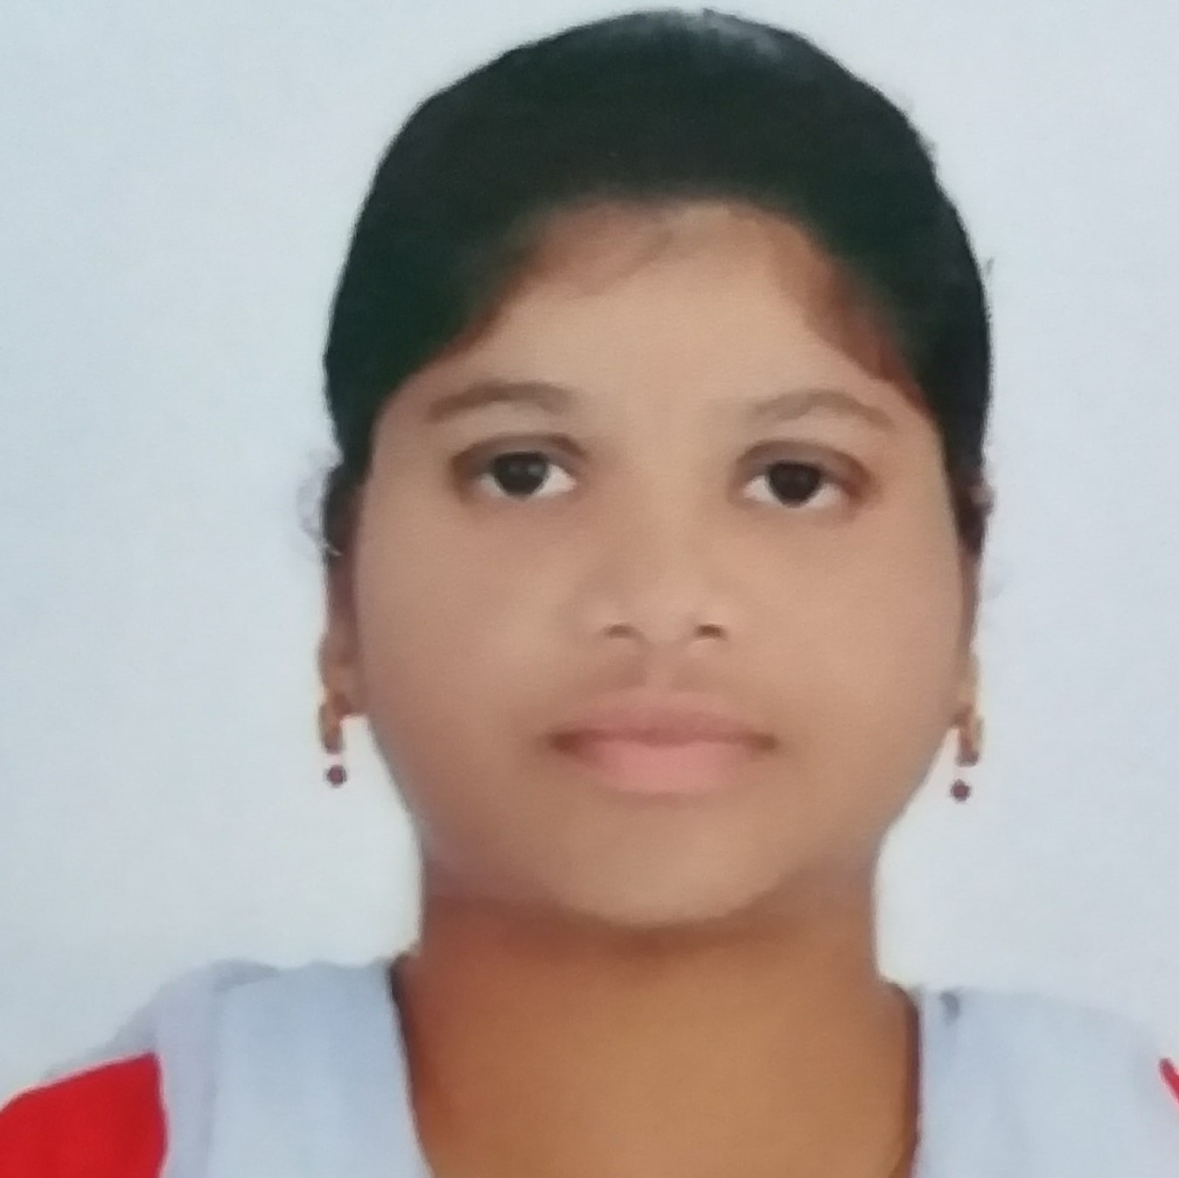
Naddunuri Leena
Analyst/Software Engineer
Bachelor of Technology
Computer science & Eng. :2017-2021
Skills Java 8 /J2EE
Spring Boot
Spring MVC
JPA CRUD
Bootstrap
React
Database
SQL database – MySQL
Web Technologies
HTML5
CSS3
JavaScript
Certification
Completed Dot Net developer certification
Completed Agile Fundamentals certification
Additional Details
Leadership
Excellent Communication Skills
Team management
Quick Learner
Hyderabad
naddunuri.leena@capgemini.com
+91 9346896050
A4
A self driven learner with Front-End and Back-End Knowledge. Passionate about implementing and launching new projects.
Ready to learn new age technologies/ frameworks and implement them to further improve my knowledge.
Hands on experience in creating Web Application with Spring boot , Java, Rest API, React.
Hands on experience in developing web pages using HTML5, CSS3, Object Oriented Programming, JSON, XML. Good understanding of Document Object Model (DOM) and DOM Functions.
Proficient in creating Web Application in React with Authentication with routing.
Experience in creating documentation with swagger and unit testing using JUnit and Mockito.
Online Food Delivery Application
Completed end to end case study of Online Food Delivery application System along with JWT authentication, API Gateway, Swagger, Postman, responsive UI with HTML5, CSS, Bootstrap and React used as User Interface.
HTML, CSS, JAVASCRIPT for web developers at Coursera
Completed this course with 91.6% and Designed responsive Restaurant website using HTML5 CSS3 Bootstrap and JavaScript.
Certifications:
Automation Anywhere University certified ESSENTIALS RPA Professional
AWS Certified Cloud practitioner (CLF-C01)
.

